Slide 1
Drugs Data Analysis
This presentation focuses on drug data analysis, highlighting key insights such as most used drugs, common side effects, drug classes, pregnancy categories, and more.
The goal is to understand trends in medications, side effects, and interactions using data visualization.
-- BY Priya Rajurkar

Slide 2
Project Overview
This project analyzes a dataset containing information about various drugs, their medical uses, side effects, classifications, and interactions. By examining these attributes, we can gain valuable insights into which drugs are most commonly used, their associated risks, and how they are categorized based on prescription type, pregnancy safety, and controlled substance status.
The analysis involves visualizing key patterns using bar charts, pie charts, scatter plots and steam graphs. These visualizations help in understanding drug usage trends, highlighting the most prescribed drug classes, and identifying potential risks such as alcohol interactions or high-risk side effects. This project is useful for healthcare professionals, researchers, and consumers seeking data-driven insights into pharmaceuticals.

Slide 3
Technology Used
1️⃣ Python Programming
Used for data cleaning, processing, and analysis.
Helps in handling large datasets efficiently.
2️⃣ Pandas
Used for data manipulation and transformation.
Helps in filtering, grouping, and summarizing drug-related information.
3️⃣ Matplotlib & Seaborn
Matplotlib: Used for creating detailed visualizations like bar charts, scatter plots, and step graphs.
Seaborn: Used for aesthetically appealing categorical and statistical visualizations such as count plots and heatmaps.
4️⃣ Data Visualization Techniques
Bar Charts, Pie Charts, Scatter Plots, Step Graphs, and Steam Graphs to highlight trends and patterns in drug usage.

Slide 4
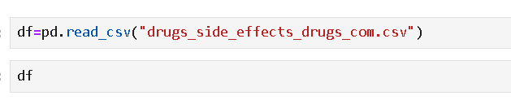

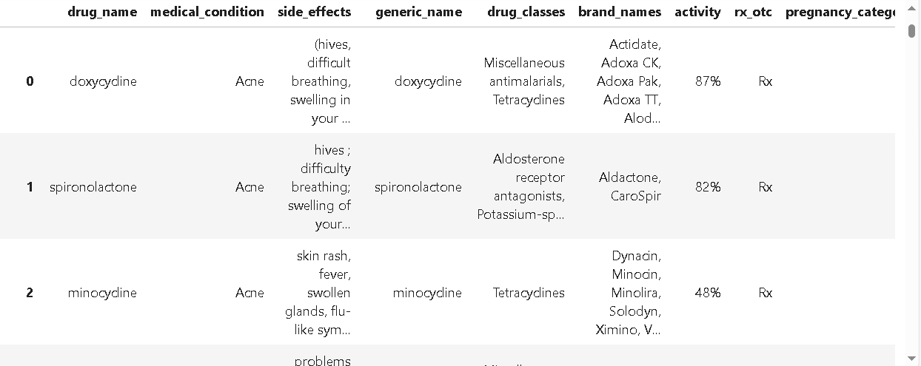
Step 1 – Read The Data

Slide 5
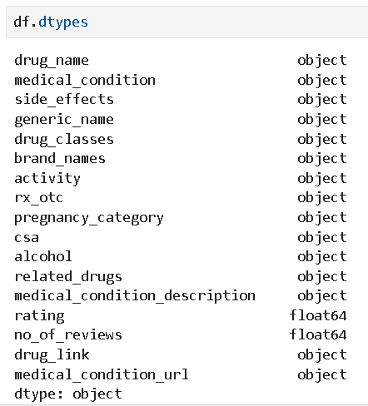
Step 2 – Checking Data Types

Slide 6


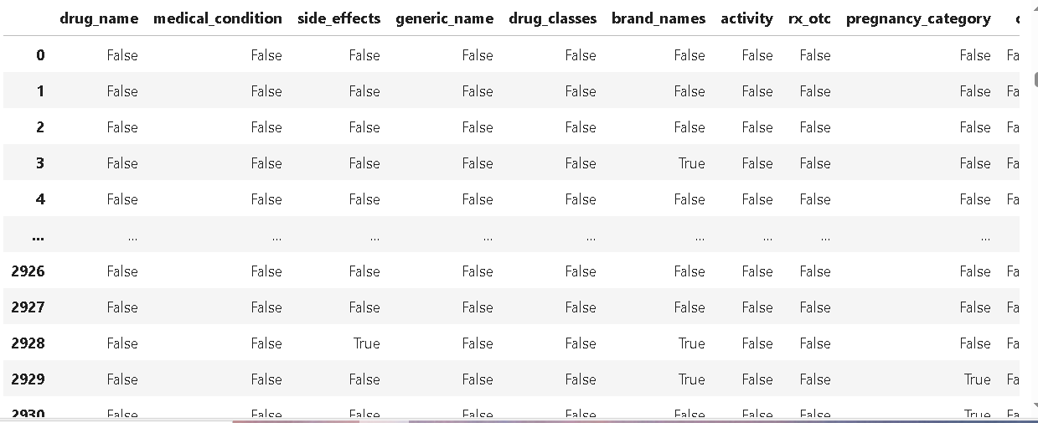
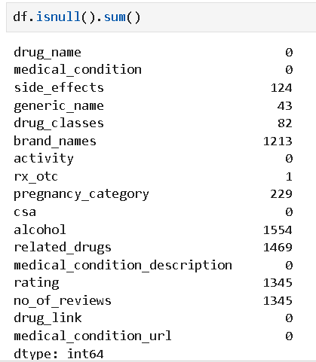
Step 3 – Finding Missing Value

Slide 7









Step 4 – Handling Missing Value

Slide 8
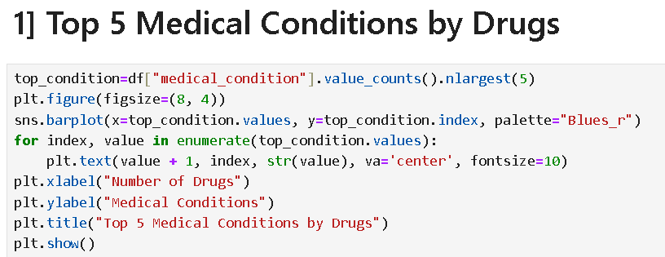
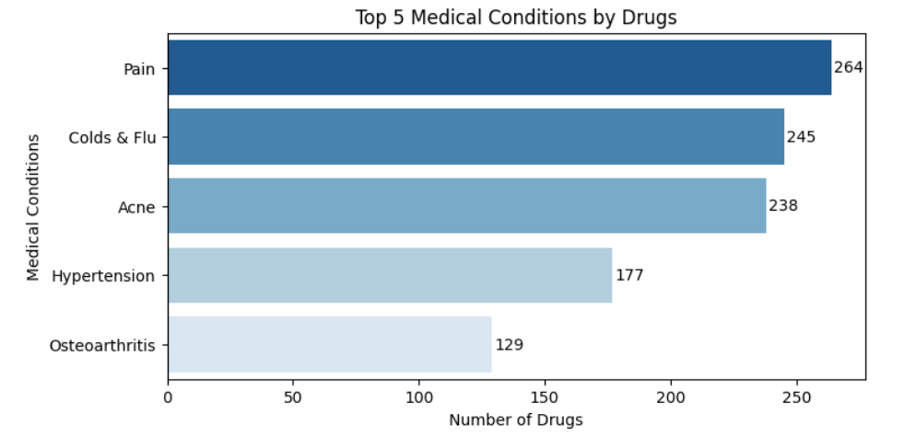
Step 5 – Insights

Slide 9
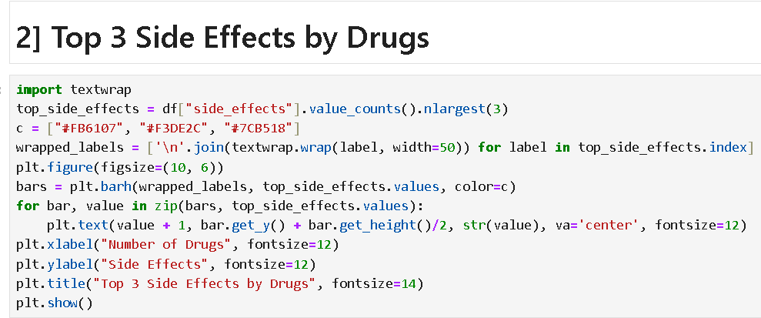
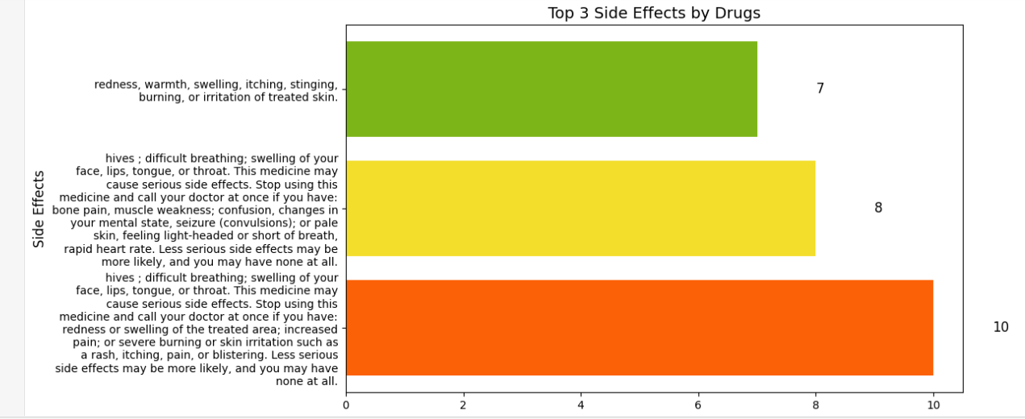


Slide 10
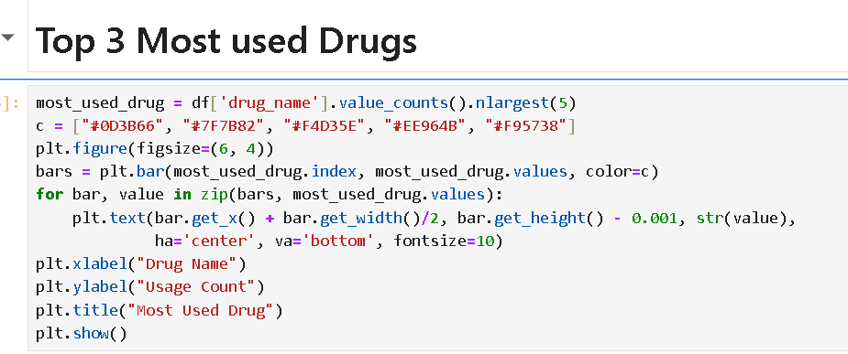
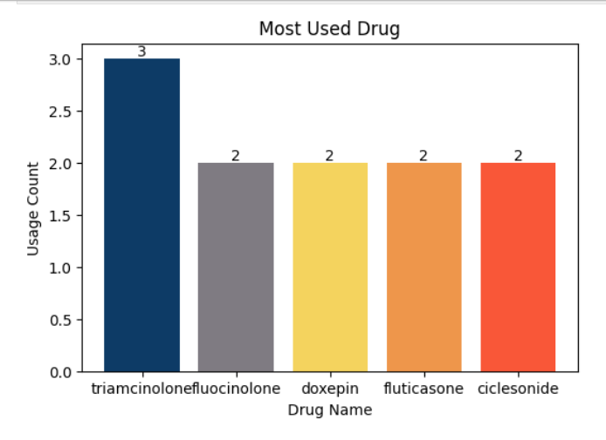

Slide 11
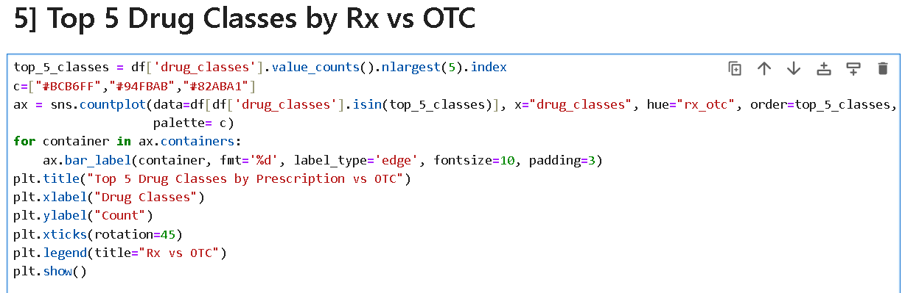
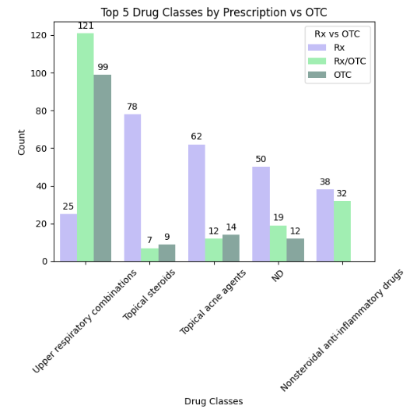

Slide 12
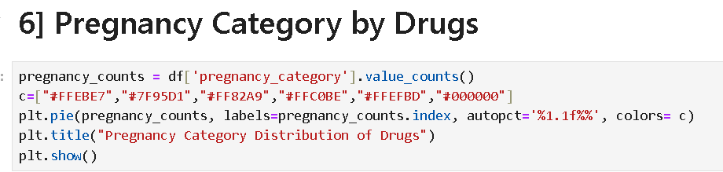
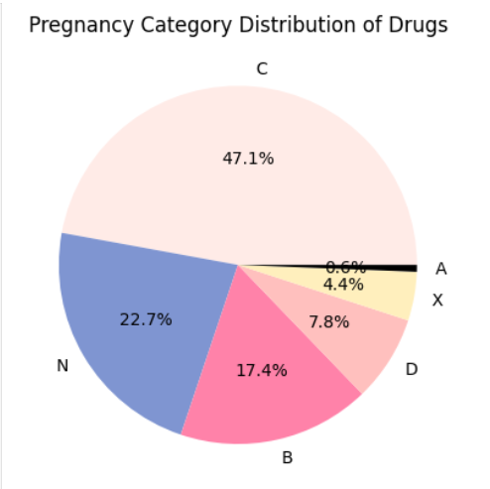

Slide 13
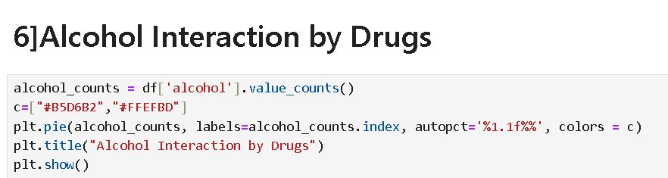
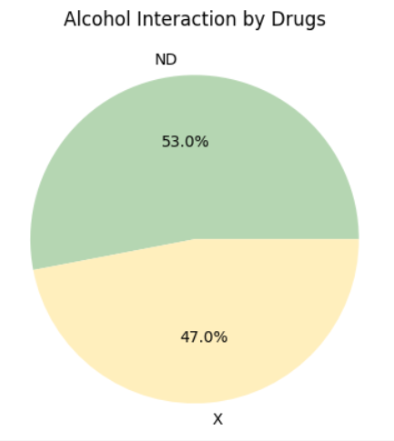

Slide 14

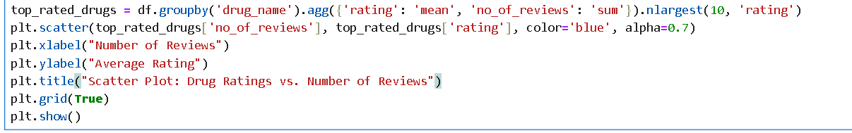
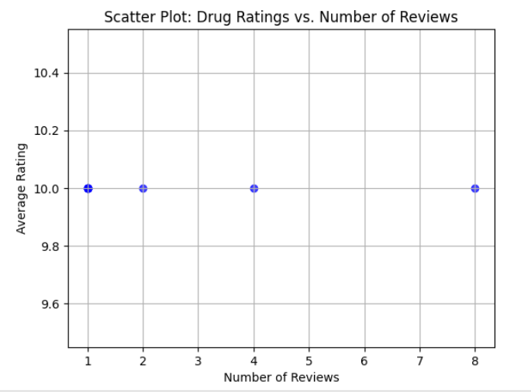

Slide 15
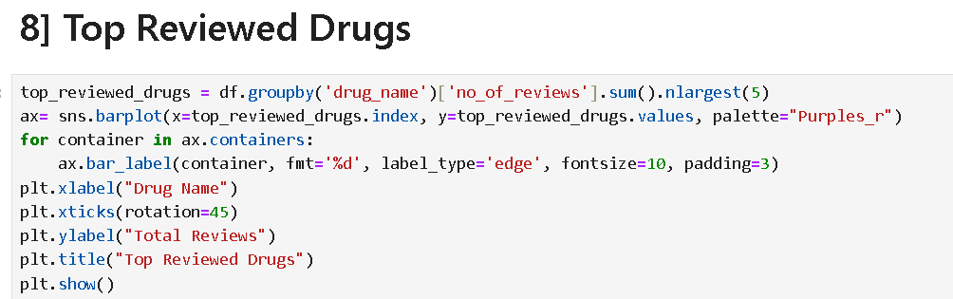
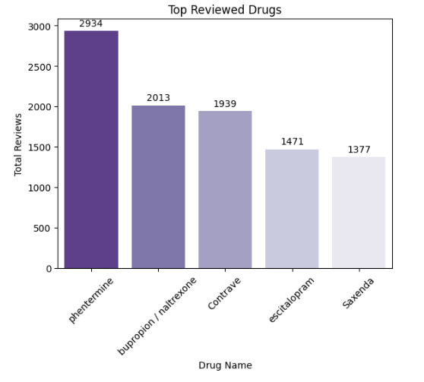

Slide 16
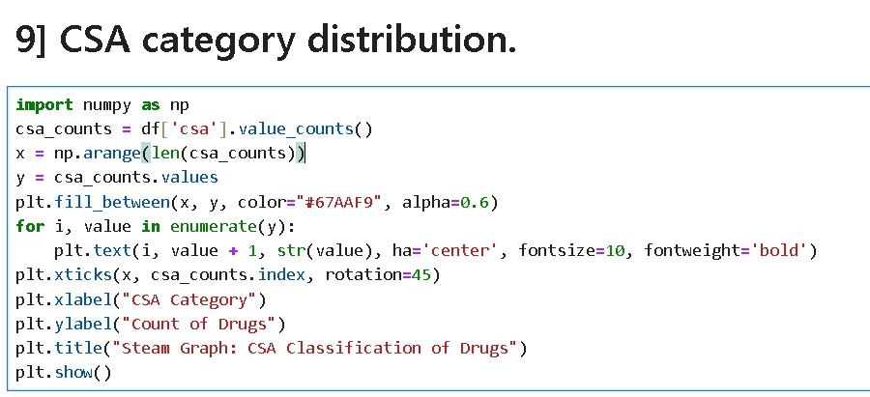
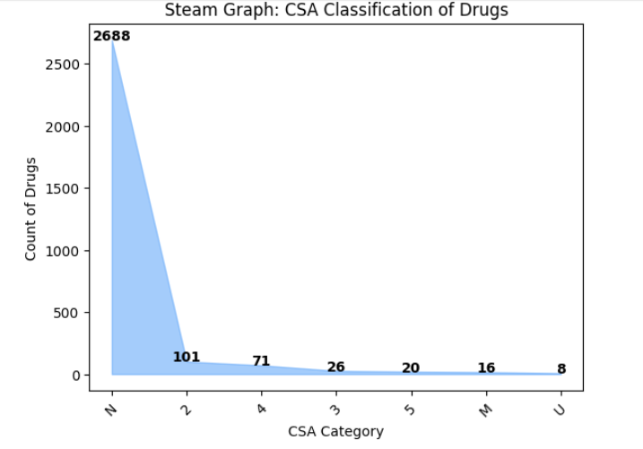

Slide 17
Summary
This project provided valuable insights into drug usage, classifications, and their effects using data analysis and visualization. By analyzing a dataset containing details about medical conditions, drug classes, side effects, and interactions, we uncovered key trends that can help healthcare professionals and consumers make informed decisions.
The analysis revealed the top medical conditions with the highest number of available drugs, the most common side effects, and the most frequently used drugs. Additionally, the study highlighted drug classifications based on prescription type (Rx vs. OTC), pregnancy safety categories, and alcohol interactions. By leveraging bar charts, pie charts, scatter plots, and step graphs, we visualized these insights effectively.
Overall, this project demonstrated the power of data-driven decision-making in the pharmaceutical industry, enabling better understanding and awareness of drug usage trends.

Slide 18
Thank you for your time and attention!
This analysis provided valuable insights into drug classifications, side effects, and interactions. We hope this information helps in making informed decisions about pharmaceuticals.

